Slide 1
Pedestrian Detection
Histograms of Oriented Gradients for Human Detection
Navneet Dalal and Bill Triggs
CVPR ‘05
Pete Barnum
March 8, 2006

Slide 2
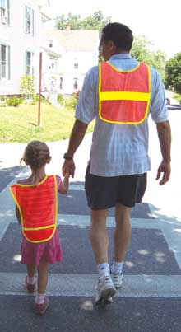
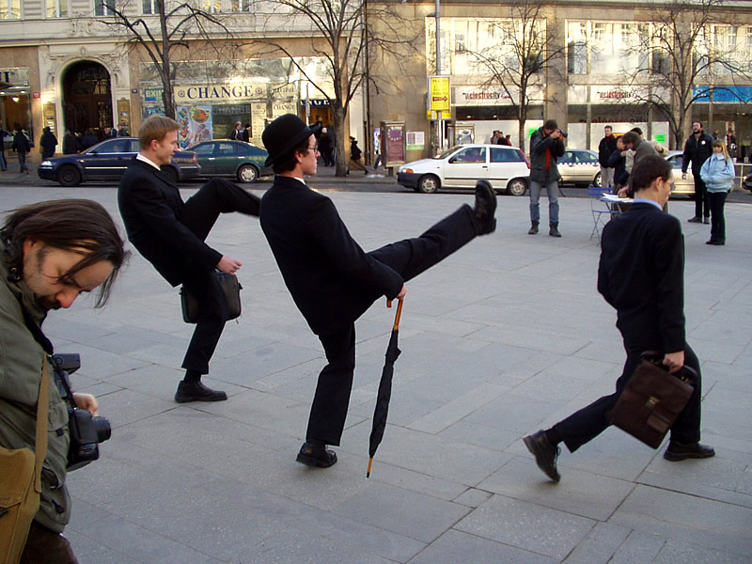
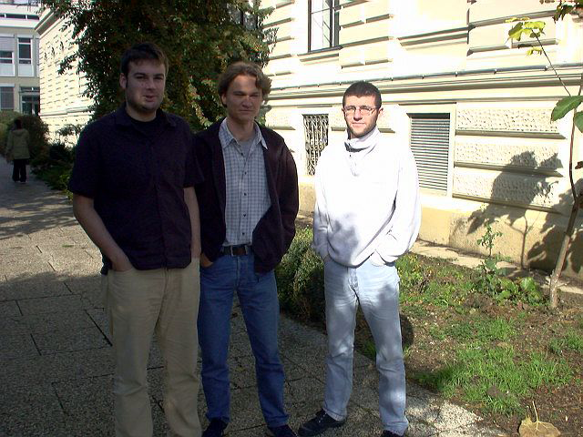
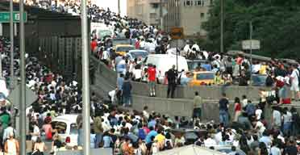

Slide 3
Challenges
Wide variety of articulated poses
Variable appearance/clothing
Complex backgrounds
Unconstrined illumination
Occlusions
Different Scales

Slide 4
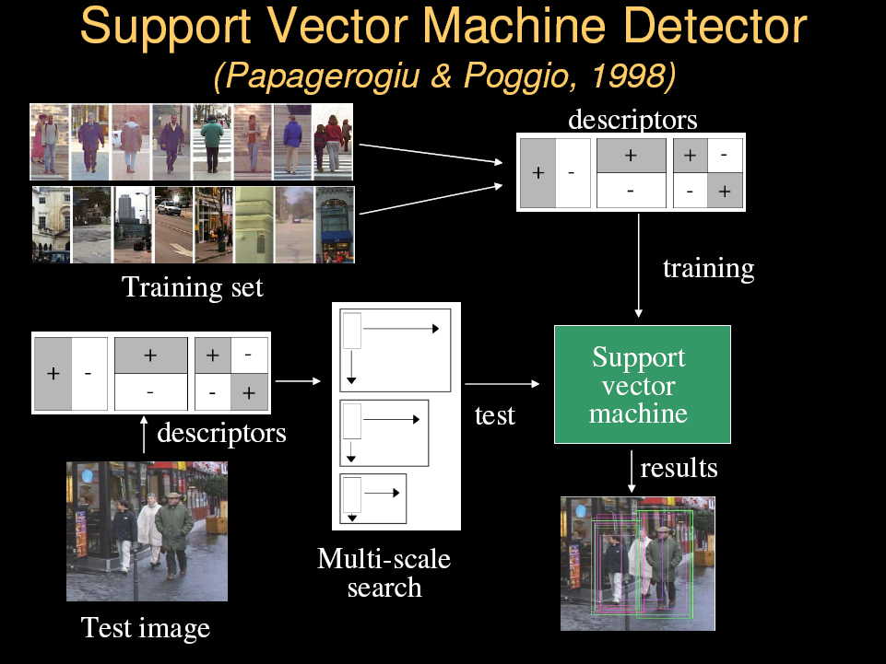
Slides from Sminchisescu

Slide 5
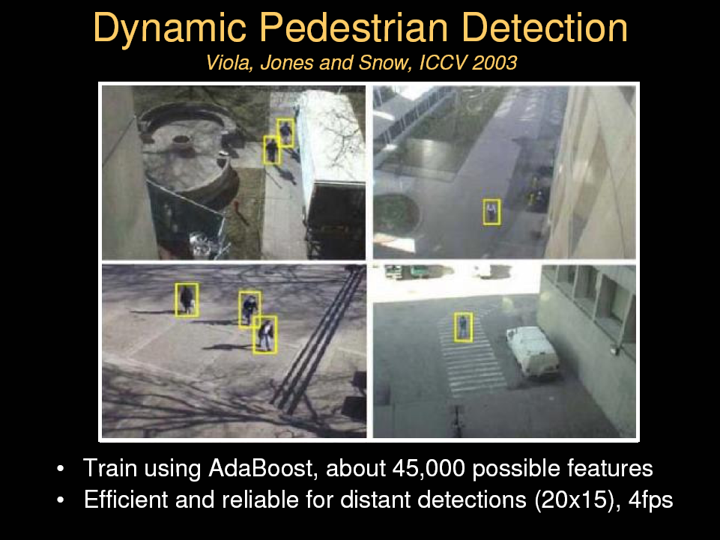
Slides from Sminchisescu

Slide 6
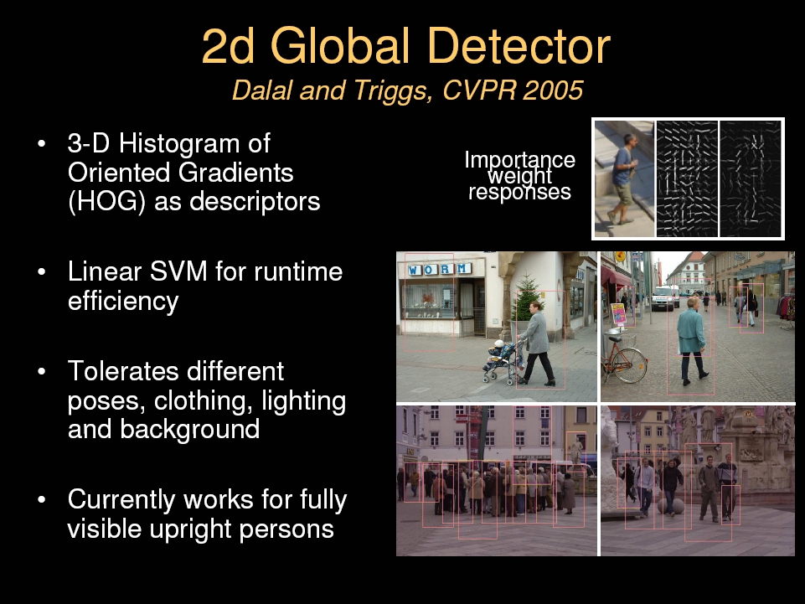
Slides from Sminchisescu

Slide 7
Feature Sets
Haar wavelets + SVM:
  Papageorgiou & Poggio (2000)
  Mohan et al (2001)
  DePoortere et al (2002)
Rectangular differential features + adaBoost:
  Viola & Jones(2001)
Parts based binary orientation position histogram + adaBoost:
  Mikolajczk et al (2004)
Edge templates + nearest neighbor:
  Gavrila & Philomen (1999)
Dynamic programming:
  Felzenszwalb & Huttenlocher (2000),
  Loffe & Forsyth (1999)
Orientation histograms:
  C.F. Freeman et al (1996)
  Lowe(1999)
Shape contexts:
  Belongie et al (2002)
PCA-SIFT:
  Ke and Sukthankar (2004)

Slide 8


Slide 9
Tested with
  RGB
  LAB
  Grayscale
Gamma Normalization and Compression
  Square root
  Log

Slide 10
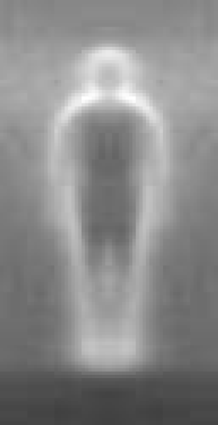

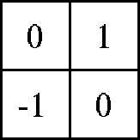

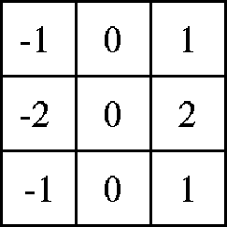

centered
diagonal
uncentered
cubic-corrected
Sobel

Slide 11
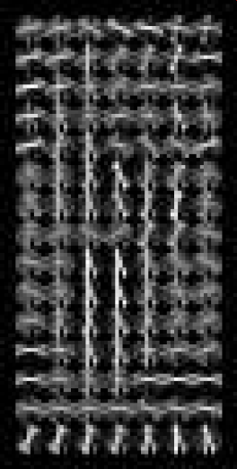
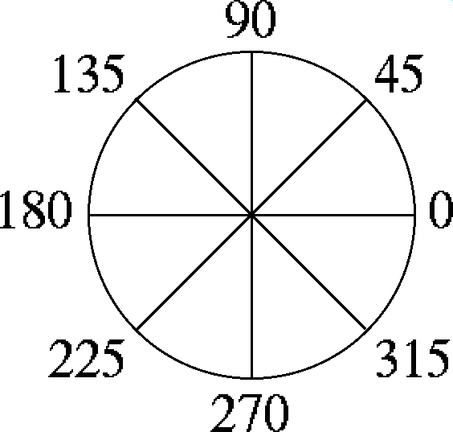
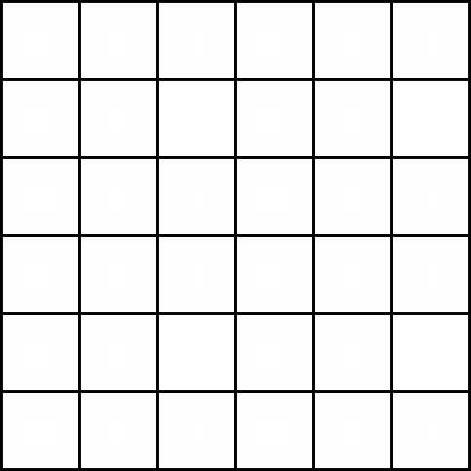
Histogram of gradient orientations
  -Orientation -Position
  Weighted by magnitude

Slide 12
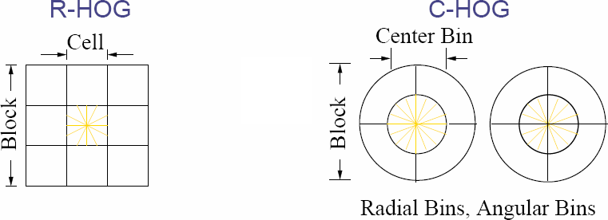

Slide 15
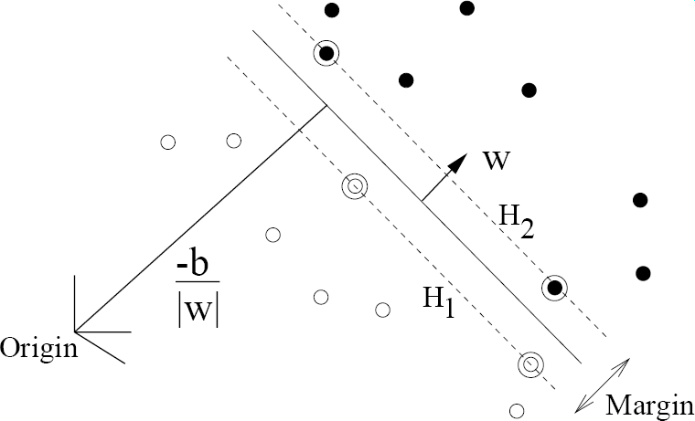

Slide 16
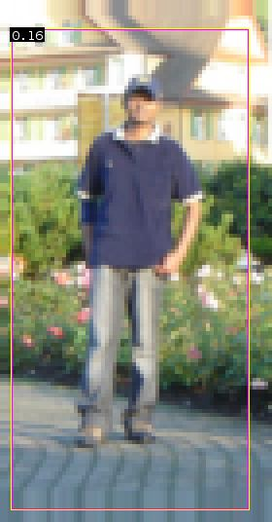

Slide 17
